Slide 1

CAPSTONE PROJECT REVIEW I Improving transparency and security of supply chain using Blockchain and Knowledge Graphs
Name : Sahil Arora
Register No: 19BCE1366
Programme & Specialization : B.Tech CSE
Guide Name:
Dr.D.Jeya Mala

Slide 2
Outline
Introduction
Literature Review (15 Latest Papers – Minimum - from Reputed Journals/Conferences)
Research Gap
Problem Statement
Research Motivation
Research Challenges
Research Objective
What is to be done next
Research Paper Status
Guide Approval mail snapshot
References

Slide 3
Introduction
The current supply chain system is riddled with disruptions and inefficiencies. The Covid-19 outbreak demonstrated to us how simple it is to completely disrupt the supply chain, leading to the downfall of entire economies.
A shipping company transporting goods across multiple transit points would require active tracking, review and approval causing lots of paperworks in the process.
Each of these approval documents / paperworks creates a point of fault, each of these points are susceptible to fraud.

Slide 4
Introduction
By executing smart contracts at each stage to automate the management of products and freight, we hope to reduce this process through blockchain and the ledger.
Blockchain possibly reduces communication or data transfer errors by giving all participants in a given supply chain access to the same information.

Slide 5
Background Work, Challenges
Working with Neo4j and Cypher queries.
Learning how to use the Bolt protocol and Neo4j protocol to connect various tools to the Neo4j graph database.
Learning how to configure and use Neo4j command line for importing and exporting data between instances.
Learning how to use Neo4j’s in hour Graph Data Science tool (GDS).

Slide 6
Learning Emblaze and embedding creation. Understanding the semantics and use cases for each function it provides.
Learning how to use on machine Blockchain deployment system (Ganache).
Learning how to implement smart contracts and writing smart contracts in solidity.
Learning how to create a storage system with solidity and handling addition and retrieval of data.
Finding the best routes available for supply chain using multiple predefined algorithms and connecting them to the blockchain and smart contracts

Slide 7
Literature Review

Slide 8
S.no | Paper | Summary | Algorithm / Technologies | Pros and Cons
[1] | Blockchain and supply chain management integration: a systematic review of the literature | The goal of this study, which analyzes 106 review papers, is to examine the existing state, possible uses, and future development of blockchain technologies. | Smart Contracts, Blockchain | It gives us a better understanding of the people working to develop blockchain technology and make them resilient to the future. No implementation or simulation
[2] | Digital Supply Chain Transformation toward Blockchain Integration | The purpose of this study is to comprehend how blockchain integration functions in business-to-business interactions where service deliveries need to be tracked to give supply chain insight. | Blockchain, Smart Contracts | They look into the specifications and capabilities of such a supply chain integration. Issues relating to openness of the blockchain were not talked about. Aspect of security was left without much discussion
[3] | Impact of COVID-19 on logistics systems and disruptions in food supply chain | Every type of unit from various sectors is experiencing COVID-19's effects. A simulation model of the public distribution system (PDS) network is created in this study with three different scenarios to show how the food supply chain can be disrupted. | anyLogistix model | Logistical Impact and re-routing were specifically noted in this study Required additional factors for re-routing protocols and how it is managed. The rerouting currently is linear in nature.

Slide 9
S.no | Paper | Summary | Algorithm / Technologies | Pros and Cons
[4] | Integrating Machine Learning, Radio Frequency Identification, and Consignment Policy for Reducing Unreliability in Smart Supply Chain Management | In the context of smart supply chain management, this study suggests a machine learning (ML) approach for on-demand forecasting. In order to reduce overstock or understock, the demand is projected using Long-Short-Term Memory (LSTM) to obtain precise demand information. | LSTM | This handles inventory control really well for items, this research provides a holistic approach for a complete supply chain solution The degree of unreliability was not taken into account, which is a current limitation of this research, even though the unreliability was reduced in the proposed model and a higher yield was produced.
[5] | Modelling Supply Chain Information Collaboration Empowered with Machine Learning Technique | This paper talks about collaborating supply chains and model them using SVMs | SVM | Handles multiple B2B supply chain well, with multiple conflict handling. unreliable set of features in social media, social events, and location-based store demographic data

Slide 10
S.no | Paper | Summary | Algorithm / Technologies | Pros and Cons
[6] | Application of machine learning techniques for supply chain demand forecasting | In this study, they examine the viability of using advanced machine learning methods, such as support vector machines, recurrent neural networks, and neural networks, to estimate distorted demand at the end of a supply chain. | Naïve Forecast, Average, Moving Average, Multiple Linear Regression, Neural Networks, Recurrent Neural Networks, Support Vector Machines | Combination of supervised learning, unsupervised learning and machine learning to find results was effective. Better pattern recognition can be used for route prediction.
[7] | Predicting supply chain risks using machine learning: The trade-off between performance and interpretability | They suggest a paradigm for predicting supply chain risks based on the collaboration of supply chain specialists and data-driven AI. | SVM, Decision Trees, ANN | The applicability of the framework is demonstrated through a real-world case study of a multi-tier aerospace manufacturing supply chain affected by the risk of delayed deliveries Extracting knowledge through data-driven techniques and using it to derive managerial insights and influence supply chain decision-making process

Slide 11
S.no | Paper | Summary | Algorithm / Technologies | Pros and Cons
[8] | The Performance Evaluation and Resilience Analysis of Supply Chain Based on Logistics Network | This study models and analyzes the supply chain using complex networks as a theoretical research tool, and it develops a supply chain network evaluation system that includes static and dynamic measurement indexes in accordance with the statistical properties of complex networks. | anyLogistix model | This study can support decision makers in a wide range of decisions in the context of supply prepositioning to prepare for and respond to disasters. his paper used a case study approach, which restricts the immediate generalizability of insights
[9] | Using Neo4j for Mining Protein Graphs: A Case Study | Given a protein structure, the aim of the PPI identification task is to pinpoint the amino acids that are necessary for the structure to bind to other proteins. | SVM, Random Decision Forests, Conditional Random Field | The use case described in this paper is quite a data intensive one operating over a relatively large graph. Lack of any substantial results, mostly a comparison between databases

Slide 12
S.no | Paper | Summary | Algorithm / Technologies | Pros and Cons
[10] | Decentid: Decentralized and privacy-preserving identity storage system using smart contracts | This paper suggests DecentID, an entirely decentralised identity storage solution that doesn't need a centralised trusted third party. As a trust anchor, a public blockchain is employed instead. | Smart Contracts, Blockchain | This method is reusable and reliable, with the use of ethereum smart contracts Interface is not defined, a random structure is prepared and used for authentication of the user.
[11] | Dstore: a distributed cloud storage system based on smart contracts and blockchain | In this article, we suggest a peer-to-peer networking environment for building the DStore client-side encrypted distributed cloud storage system. Without relying on centralised management by vetted third parties, DStore enables data owners to rent the local idle discs of other peers to store personal data in a distributed manner. | AES Encryption, Smart Contracts | Reliable file storage which allows for files to be stored in blocks which AES encrypted. No standardization of the file storage smart contract, which was written in solidity.

Slide 13
S.no | Paper | Summary | Algorithm / Technologies | Pros and Cons
[12] | Machine Learning Model for Smart Contracts Security Analysis | They presented a machine learning predictive model in this paper that recognises patterns of security flaws in smart contracts. More than 1000 smart contracts that were confirmed and used on the Ethereum platform were labelled using two static code analyzers that we modified. | Random Forest, SVM, Neural Network | Useful in finding out the standard issue of smart contracts This is mostly code analysis, Models are trained to tell if some patterns are visible in the solidity code or not. Cases of false positives are visible.
[13] | Route planning on GTFS using Neo4j | The purpose of this study is to analyse how Neo4j, a database management system, can enable public transportation route planning systems using GTFS (General Transit Feed Specification) inputs. | K shortest path, A* algorithm, shortest path | The graph database model is particularly useful when data connectivity of the data is as important as the data itself. The graph is not densely connected. There could have been a better model for the graph.

Slide 14
S.no | Paper | Summary | Algorithm / Technologies | Pros and Cons
[14] | Representing temporal knowledge in conceptual graphs | This research was conducted as part of the lengthy GENTEXT (Generation of Text) project, which aims to create a system that can produce writings in the French language starting with knowledge structures expressed in a manner similar to Sowa's conceptual graphs. | CGs models | his work has highlighted a number of interesting problems concerning the underlying theory and its implementation the temporal structure and logic of the meta-level components of a CGs model, e.g. of the inheritance hierarchies, definitions and the canonical models will require further intensive study.
[15] | Analyzing Open Shortest Path First (OSPF) Networks with Neo4j and Cypher | This system analyses OSPF using Neo4j and finding the best route possible | OSPF, Dijkstra Algorithm | Neo4j effortlessly produces a competent network diagram diagram is missing many details that a network technician would ordinarily need

Slide 15
Research Gap
Blockchain and the data stored in it exist only in the digital realm. Interfacing the data tracked in the blocks to the physical goods being traced requires other technologies.
By implementing blockchain technologies, stakeholders can better manage the supply chain by keeping track of information such as price, date, location, quality, certification, and other pertinent details.
The availability of this data within blockchain can improve visibility and compliance over outsourced contract manufacturing, increase traceability of the material supply chain, reduce losses from gray market and counterfeit products, and possibly strengthen an organization's position as a pioneer in ethical manufacturing.
Businesses can improve their supply chain management through more transparent and accurate end-to-end tracking. We hope to deliver the optimal routes based on a variety of parameters, improving logistical efficiency, using Neo4j and knowledge graphs

Slide 16
Problem Statement
Blockchain and the data stored in it exist only in the digital realm. Interfacing the data tracked in the blocks to the physical goods being traced requires other technologies.
By implementing blockchain technologies, stakeholders can better manage the supply chain by keeping track of information such as price, date, location, quality, certification, and other pertinent details.
The availability of this data within blockchain can improve visibility and compliance over outsourced contract manufacturing, increase traceability of the material supply chain, reduce losses from gray market and counterfeit products, and possibly strengthen an organization's position as a pioneer in ethical manufacturing.
Businesses can improve their supply chain management through more transparent and accurate end-to-end tracking. We hope to deliver the optimal routes based on a variety of parameters, improving logistical efficiency, using Neo4j and knowledge graphs

Slide 17
Research Motivation
Graphs and Blockchain and both technologies that are new and upcoming and also less researched upon.
The application of graphs in real world use cases is currently pretty limited.
Studying graphs through a framework provides answers to many arrangement, networking, optimization, matching and operational problems.

Slide 18
Research Challenges
Why use graph databases rather than using a normal relations database?
What novel idea does it provide that is not provided by relational databases?
Why use smart contracts to store information rather than using a inhouse database?
What are the security concerns of such a system?
What are the upkeep requirements and costs of such a system?

Slide 19
Research objectives
Increase traceability of goods in supply chain to ensure corporate standards are met
Lower losses from counterfeit/gray market trading
Improve visibility and compliance over outsourced contract manufacturing
Reduce paperwork and administrative hurdles
Availability of this data within blockchain can improve visibility and compliance over outsourced contract manufacturing, increase traceability of the material supply chain

Slide 20
Work to be Completed
Finding the best route between airports still require better approach
Connecting smart contracts and Neo4j together
Finding the trend results generated form embedding and documenting them

Slide 21
Guide Approval Snapshot

Slide 22
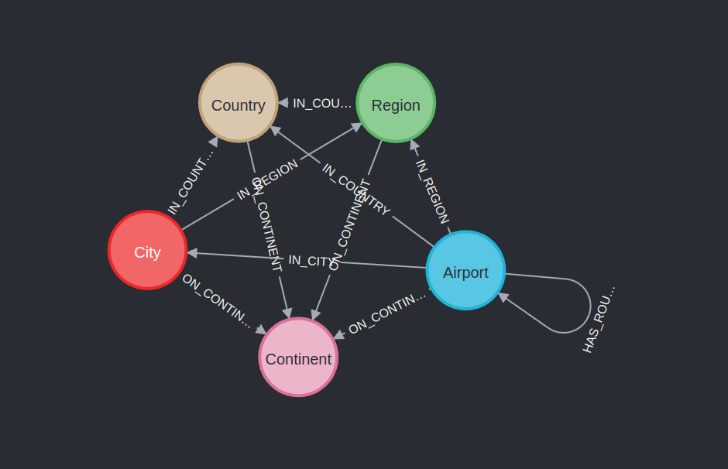
Current Progress
Graph Schema

Slide 23
Dataset Information
"Continent": 6,
"Airport": 3503,
"Region": 1527,
"Country": 232,
"City": 3359
"Routes": 9355
"Total relations": 73954

Slide 24
References
Queiroz, M.M., Telles, R., & Bonilla, S.H. (2019). Blockchain and supply chain management integration: a systematic review of the literature. Supply Chain Management: An International Journal.
Korpela, K., Hallikas, J., & Dahlberg, T. (2017). Digital Supply Chain Transformation toward Blockchain Integration. HICSS.
Singh, S., Kumar, R., Panchal, R., & Tiwari, M.K. (2021). Impact of COVID-19 on logistics systems and disruptions in food supply chain. International Journal of Production Research, 59, 1993 - 2008.
Sardar, S.K., Sarkar, B., & Kim, B. (2021). Integrating Machine Learning, Radio Frequency Identification, and Consignment Policy for Reducing Unreliability in Smart Supply Chain Management. Processes.
Ali, N., Ahmed, A., Anum, L., Ghazal, T. M., Abbas, S., Khan, M. A., ... & Ahmad, M. (2021). Modelling supply chain information collaboration empowered with machine learning technique.
Carbonneau, R., Laframboise, K., & Vahidov, R. (2008). Application of machine learning techniques for supply chain demand forecasting. European Journal of Operational Research, 184(3), 1140-1154.
Baryannis, G., Dani, S., & Antoniou, G. (2019). Predicting supply chain risks using machine learning: The trade-off between performance and interpretability. Future Generation Computer Systems, 101, 993-1004.
Sun, W., Li, Y., & Shi, L. (2020, July). The Performance Evaluation and Resilience Analysis of Supply Chain Based on Logistics Network. In 2020 39th Chinese Control Conference (CCC) (pp. 5772-5777). IEEE.
Hoksza, D., & Jelínek, J. (2015, September). Using Neo4j for mining protein graphs: a case study. In 2015 26th International Workshop on Database and Expert Systems Applications (DEXA) (pp. 230-234). IEEE.
Friebe, S., Sobik, I., & Zitterbart, M. (2018, August). Decentid: Decentralized and privacy-preserving identity storage system using smart contracts. In 2018 17th IEEE International Conference On Trust, Security And Privacy In Computing And Communications/12th IEEE International Conference On Big Data Science And Engineering (TrustCom/BigDataSE) (pp. 37-42). IEEE.
Xue, J., Xu, C., Zhang, Y., & Bai, L. (2018, November). Dstore: a distributed cloud storage system based on smart contracts and blockchain. In International Conference on Algorithms and Architectures for Parallel Processing (pp. 385-401). Springer, Cham.
Momeni, P., Wang, Y., & Samavi, R. (2019, August). Machine learning model for smart contracts security analysis. In 2019 17th International Conference on Privacy, Security and Trust (PST) (pp. 1-6). IEEE.
Vágner, A. (2021). Route planning on GTFS using Neo4j. In Annales Mathematicae et Informaticae (Vol. 54, pp. 163-179). Eszterházy Károly Egyetem Líceum Kiadó.
Moulin, B., & Côté, D. (1991). Representing temporal knowledge in conceptual graphs. Knowledge-Based Systems, 4(4), 197-208.
Holden, W. J. Analyzing Open Shortest Path First (OSPF) Networks with Neo4j and Cypher.

Slide 25
Thank You

